Slide 1

Predictive Analysis with LSTM on HealthCare Dataset
Final Project Presentation
Aayush Adhikari

Slide 2
Dataset Description
We have patient medical records including demographics (age, gender, blood type), medical conditions (diabetes, asthma), healthcare interactions (admission date, discharge date, hospital, insurance) and billing details.
The dataset provides comprehensive information to model patient outcomes based on historical data

Slide 3
Tasks:
Predict Outcomes: Use LSTM model to predict discharge dates, billing amounts and test results.
Business Objective: Assist healthcare providers in better planning resource allocation and estimate costs and improve patient care efficiency.

Slide 4
Lstm because:
Sequential Data: Since dataset includes time-series information which will be useful for LSTM to learn temporal dependencies.
Long-Term Dependencies: LSTMs are good at remembering information over long sequences, making them suitable for predicting outcomes based on past medical history and treatment.
Accuracy: Given the sequential and temporal nature of medical data, LSTM provides a robust approach to making future predictions like discharge date and billing amounts.

Slide 5
Expected Output
Predictions:
Billing Amount: Estimate total billing based on patient profile, hospital stay duration, and insurance provider.

Slide 6
Project Plan
Data Preparations and Preprocess
Model Building
Model Evaluation and Tuning
Results and Deployment

Slide 7
Data preparation
Preprocessing:
Involved filling missing values with column means.
Encoded categorical features using LabelEncoder.
Calculated the duration of hospital stay.
Used Min Max Scaler scale numerical features.

Slide 8
Model Development
Model:
Developed LSTM network with one dense layer for regression problem for predicting billing amount based on hospital stay duration, insurance provider and medical condition.
Loss Function:
Mean Squared Error
Evaluation Metrics:
Mean Absolute Error
Mean Squared Error
R²

Slide 9
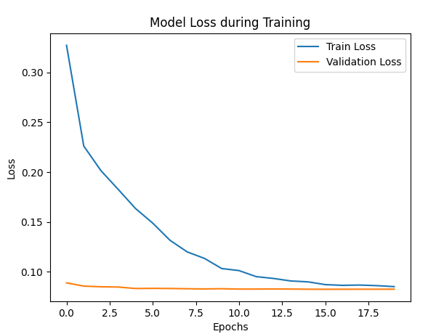
Output and Results
Training Results:
Final Training Loss: 0.0848
Final Validation Loss: 0.0825
Test Results:
Mean Absolute Error: 0.248
Mean Squared Error: 0.0825
R²: -0.0007

Slide 10
Findings
Observation:
Training and validation losses show consistent improvement, which indicated low overfitting problem while learning.
Test validation loss matches the training validation results, ensures reliability.
Issue:
Negative R² suggesting that the model fails to explain the variance in the target variable which could be the result of underfitting.
Discussion:
The model complexity or some missing features could be the reason of negative variance.
Further data preparation and further feature engineering could improve the results.

Slide 11
Conclusion
Summary:
Model performance demonstrates basic learning but needs improvement for real world application.
Further Enhancement:
Feature Engineering
Create a deeper architectures and test on different models.
Hypermeter tuning for better optimization

Slide 12

Thank you!!!

